Slide 1
Design Patterns & Principles
Narendran Solai Sridharan

Slide 2
Design Pattern
What is a pattern?
What is an Anti Pattern?
What is design pattern?
Why is it necessary to know about Design Patterns?
Do Designs need to be Maintained?
Notes:
Any thing that repeats in order forms a pattern. In the problem-solution context, any solution which repeats for a certain kind of problems is called as Pattern. (Reuse Design experience, opposed to code experience)
Not all patterns provides good solutions sometimes pattern which is repeating also form the frequent pitfalls, such patterns are called Anti Pattern.
Design solution which gets repeated form Design Patterns.
Design patterns helps us to come up with a good solution for a given problem in a given context.
Knowledge on Design patterns also help us to maintain any application Design from Rotting.
Applications evolves with the recent changes in the technology or business. Maintenance of good Design also is importance as much as the application functionality.

Slide 3
Symptoms of Rotting Design
Rigidity – not Flexible
Fragility – not Robust
Immobility – not Modular to reuse
Viscosity – Complex Designs
Notes:
Rigidity – Unable to make changes in the design easily. Requires Cascaded Changes in Dependent Modules.
Fragility – Changes creates unpredictable outcomes.
Immobility – Unable to use a part of the module in some other System.
Viscosity – Hacking the system is easy than using a proper design.

Slide 4
Causes for Rot
Changing Requirements (Requirement Document – Most Volatile) – Design Change should be resilient to Requirement Changes.
Dependency Management not properly done – Create Dependency Firewalls to evade Unwanted dependency.

Slide 5
OOCD – Principles - Major
The Open Closed Principle (OCP) - A module should be open for extension but closed for modification.
The Liskov Substitution Principle (LSP) -Subclasses should be substitutable for their base classes.
The Dependency Inversion Principle (DIP) - Depend upon Abstractions. Do not depend upon concretions.
The Interface Segregation Principle (ISP) - Many client specific interfaces are better than one general purpose interface

Slide 6
OOCD – Principles - Minor
HollyWood Principle – Don’t call us, We will call you.
Encapsulate what varies.
Favor Composition over Inheritance.
one class one responsibility.
Principle of Least Knowledge - talk only to your immediate friends – Law of Demeter

Slide 7
Principles of Package Architecture
Package Cohesion Principles

Slide 8
Principles of Package Architecture
The Release Reuse Equivalency Principle (REP) -The granule of reuse is the granule of release.
The Common Closure Principle (CCP) - Classes that change together, belong together.
The Common Reuse Principle (CRP) - Classes that aren’t reused together should not be grouped together.
Notes:
We create a product and release it into the market.
Product should have reusable parts which could be easily replaceable either for enhancement or for bugs/repairs.
The components should serve unique purposes with a common idea.

Slide 9
Principles of Package Architecture
The REP and CRP makes life easy for reusers, whereas the CCP makes life easier for maintainers.
The CCP strives to make packages as large as possible (after all, if all the classes live in just one package, then only one package will ever change). The CRP, however, tries to make packages very small.
Early in a project, architects may set up the package structure such that CCP dominates and development and maintenance is aided. Later, as the architecture stabilizes, the architects may refractor the package structure to maximize REP and CRP for the external reusers.

Slide 10
Principles of Package Architecture
The Package Coupling Principles

Slide 11
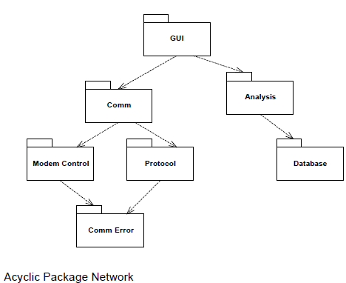
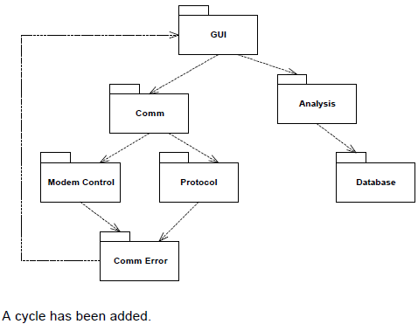
Principles of Package Architecture
The Acyclic Dependencies Principle (ADP) - The dependencies between packages must not form cycles.
DIP & ISP can be used to break Cyclic dependency.

Slide 12
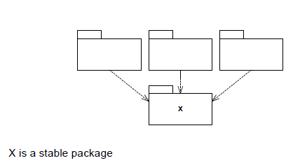
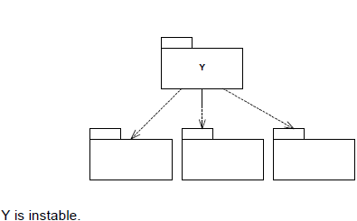
Principles of Package Architecture
The Stable Dependencies Principle (SDP) - Depend in the direction of stability.
Stability is related to the amount of work required to make a change – if work is huge, it is very stable.

Slide 13
Principles of Package Architecture
Stability Metrics
Instability. I = Ce / (Ca + Ce) This is a metric that has the range: [0,1].
Ca Afferent Coupling. (i.e. incoming dependencies)
Ce Efferent Coupling. (i.e. outgoing dependencies)
Software that is flexible in the presence of changing requirements is thought well of. Yet that software is instable by our definition. Indeed, we greatly desire that portions of our software be instable. We want certain modules to be easy to change so that when requirements drift, the design can respond with ease

Slide 14
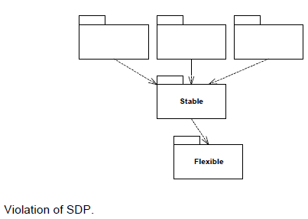
Principles of Package Architecture
The Stable Abstractions Principle (SAP) - Stable packages should be abstract packages.
Clearly, the more packages that are hard to change, the less flexible our overall design will be. However, there is a loophole we can crawl through. The highly stable packages at the bottom of the dependency network may be very difficult to change, but according to the OCP they do not have to be difficult to extend!
it is possible to compose our application from instable packages that are easy to change, and stable packages that are easy to extend by making the stable part abstract. Thus, the SAP is just a restatement of the DIP.

Slide 15
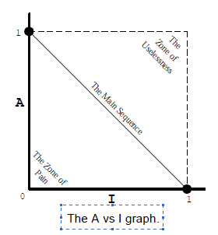
Principles of Package Architecture
The Abstractness Metrics
Abstractness A = Na / Nc
Nc Number of classes in the package
Na Number of abstract classes in
the package.
The I vs A graph
Distance Metrics – To measure distance from
Main Sequence.
Distance D = |A+I -1| / √2, Noramalised Distance D’ = |A+I -1|.
D’=0, Package directly on Main Sequence.
D’=1, Package far away from Main Sequence.

Slide 16
Java Design Pattern
Design Pattern Specific to Java Programming Language form the Java Design Pattern.
Java Language already have some semantics to support some the design pattern.
Any New changes coming up in Java also will help us to construct new patterns and also to enhance/deprecate the existing patterns.

Slide 17
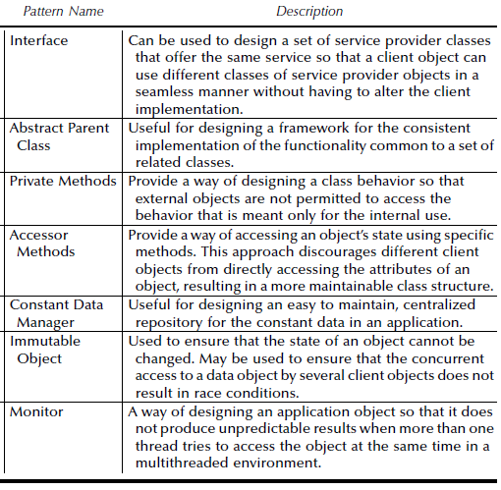
Basic Java Patterns

Slide 18
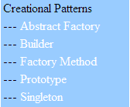
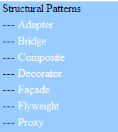
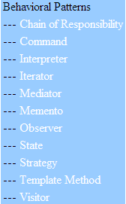
Types of Design Patterns – 23 GOF
Constructing objects
Controlling heap layout
Affecting object
semantics

Slide 19
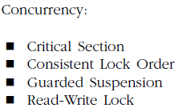

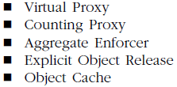

Other Design Patterns

Slide 20
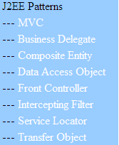
J2EE Patterns

Slide 21
Performance Pattern
1.Fast Path: Improving response time by reducing process time required for dominant workloads.
2.First Things First: Omit the least important tasks if it is not possible to execute all tasks in given time.
3.Coupling: Aggregate frequently used data / functions to reduce number of interactions.
4.Batching: Combine requests into a batch for saving on overhead processing time.
5.Alternate routes: Spread high usage objects spatially to reduce contention time.

Slide 22
Performance Pattern
Amortization
Simplification
Profiling
Indexing
Partitioning
Redundancy Reduction
Parallel Processing – Threading
Asynchronous Processing
Caching
Proxy, Prototype, Object Pooling

Slide 23
References
More Patterns
http://c2.com/cgi/wiki?PortlandPatternRepository
http://hillside.net/patterns/
https://www.it.uu.se/edu/course/homepage/devgui2/vt09/tip/html/TIPatterns.htm
Material Reference
Design Principles and Design Patterns by Robert C. Martin
http://www.objectmentor.com/
Software Architecture Design Patterns in Java by Partha Kuchana

